Slide 1
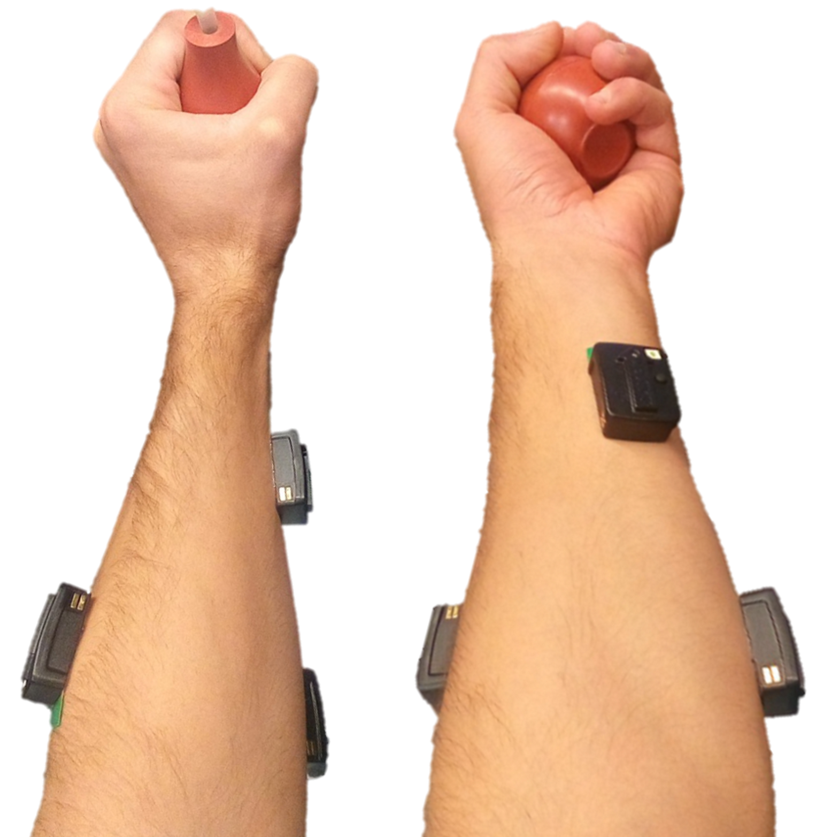
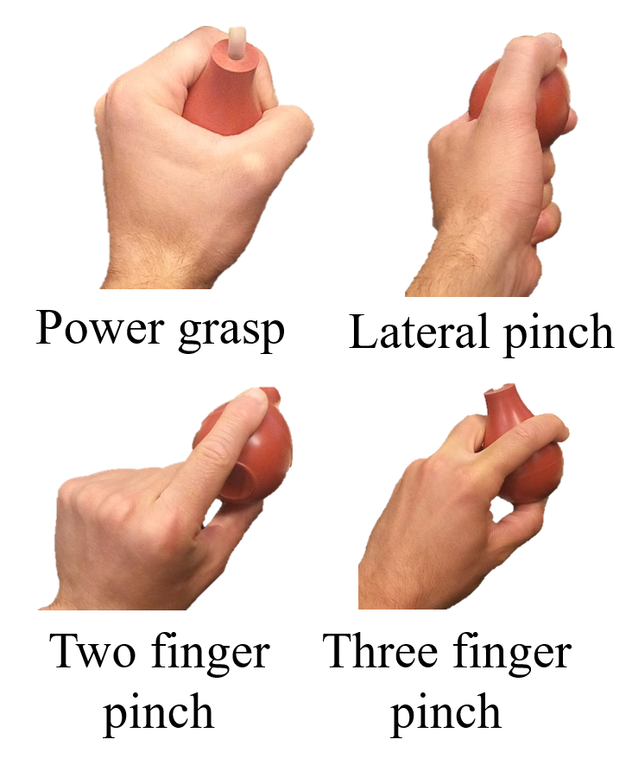
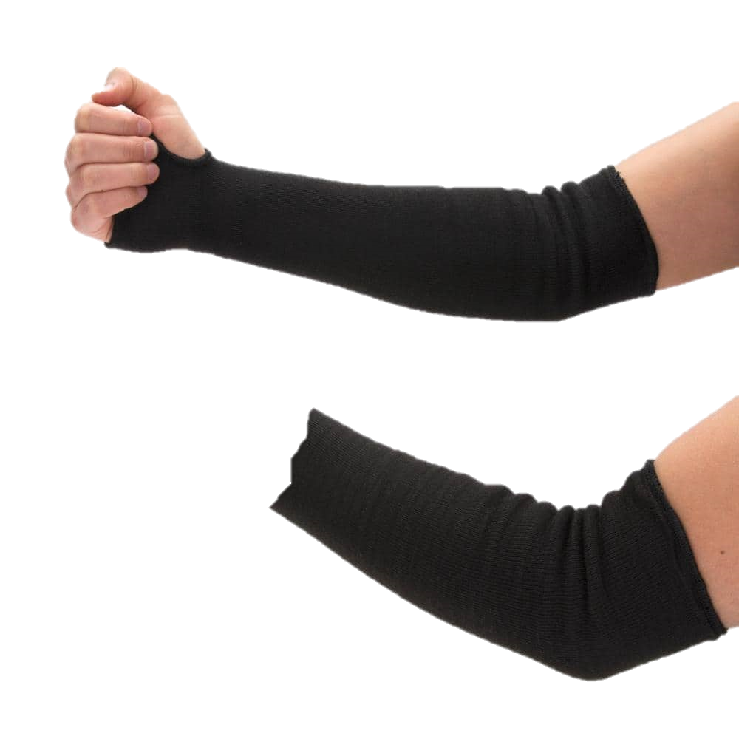
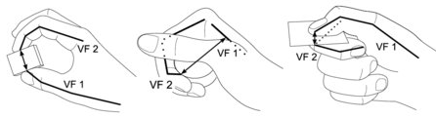
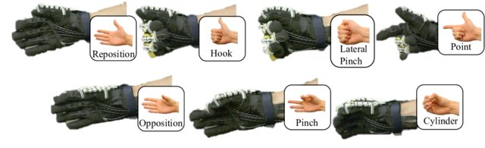
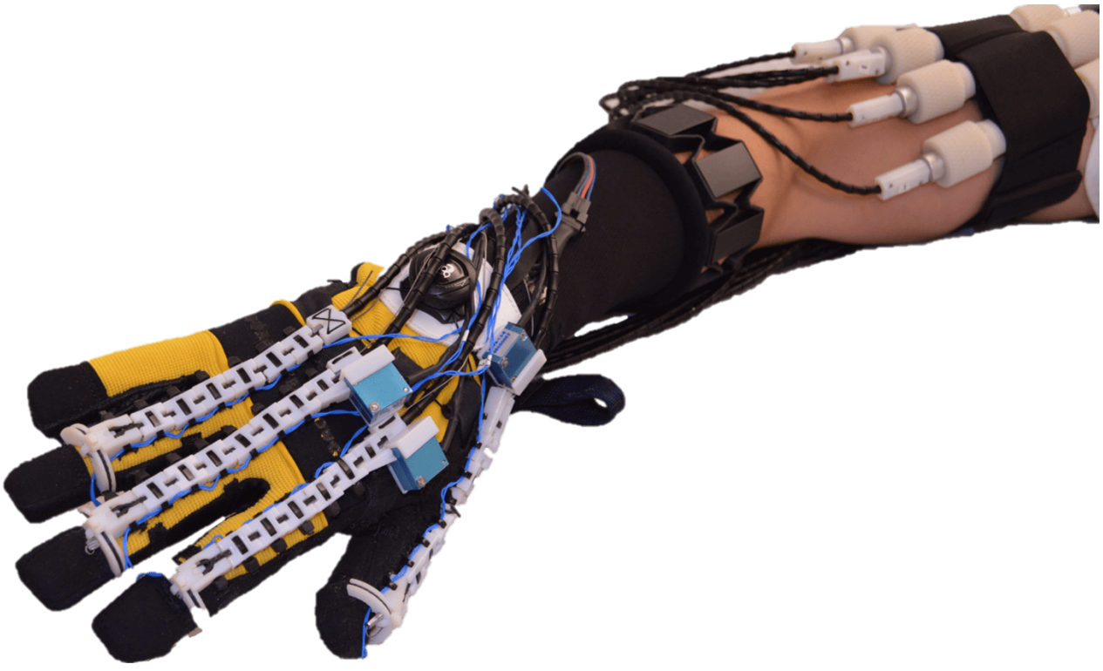
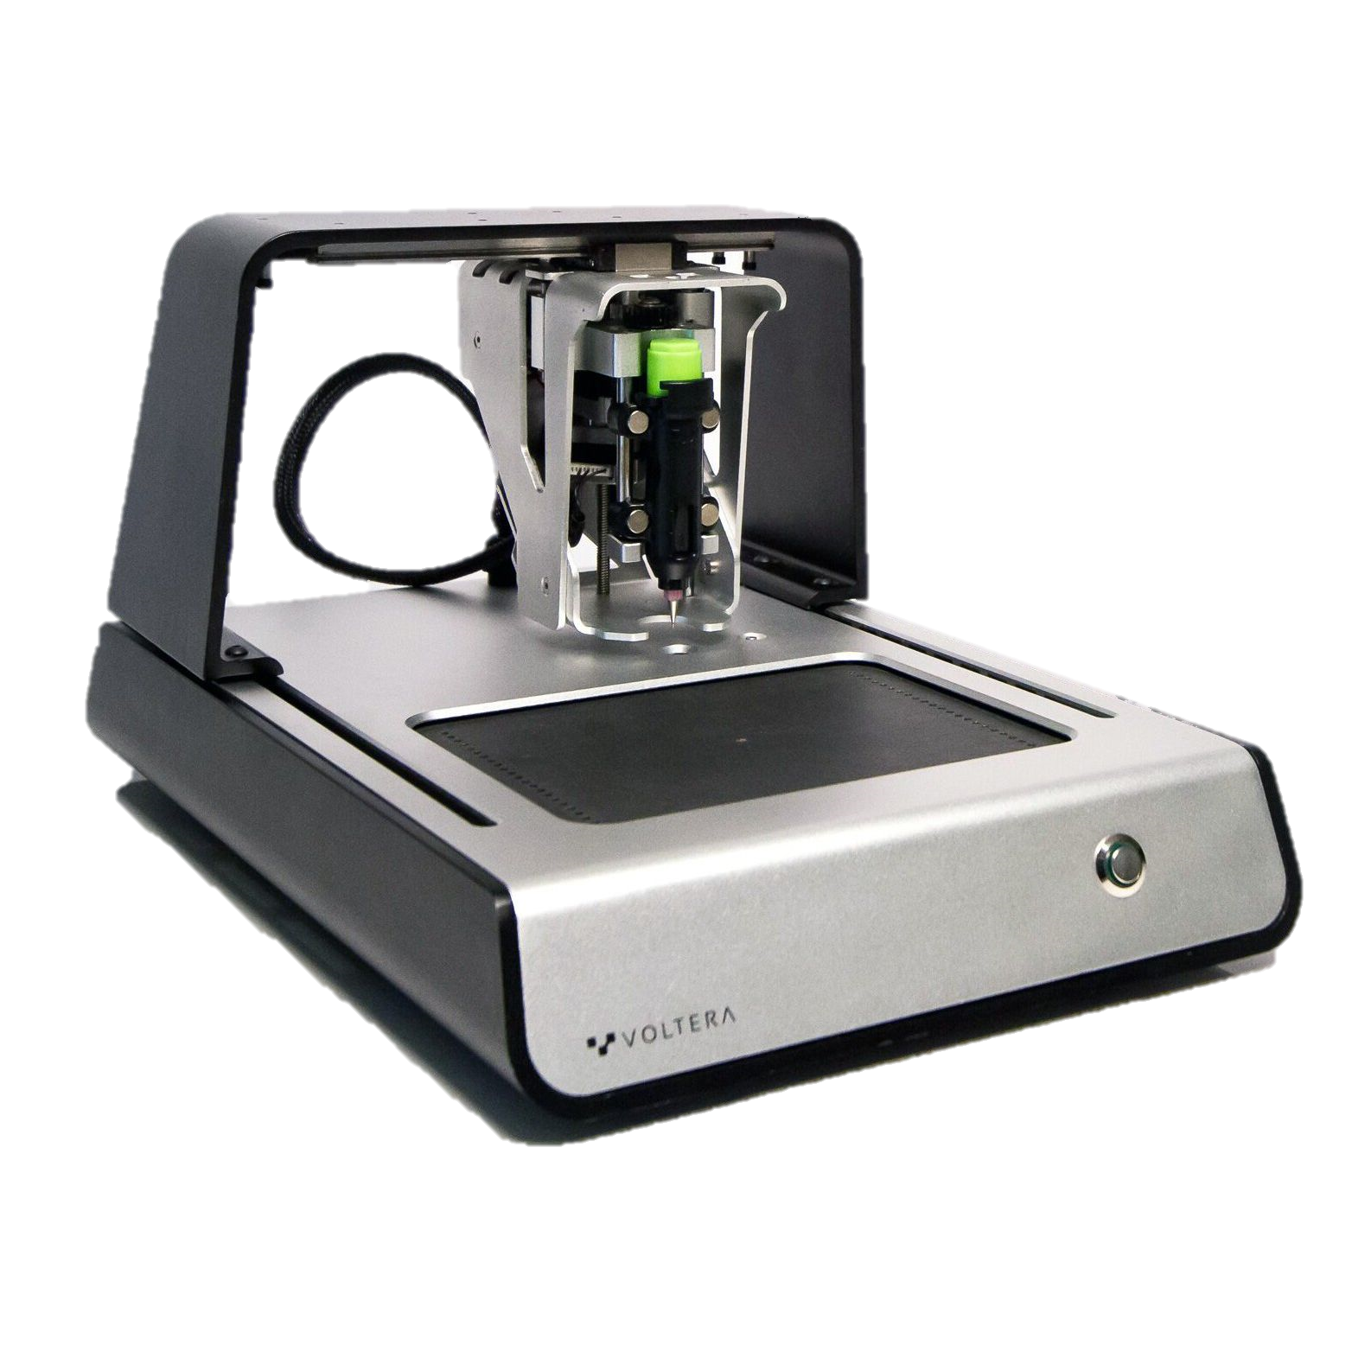
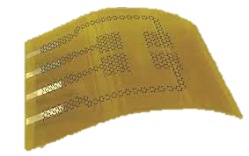
Year 1:
Validation of muscle fatigue monitoring algorithm via human trials
Design and construction of an sEMG sensorized garment
Year 2:
Real-time control of robotic glove with sEMG garment
Year 2:
Validation of sEMG-based control of robotic glove with human participants performing functional EVA tasks
Feix et. al.
Fatigue
f[Hz], t[S]
Rose et. al.
Rose et. al.
Rose et. al.
(Design placeholder for printed flexible electrode)

